Slide 1

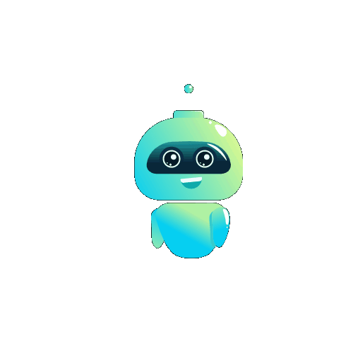
Link Mine 2024
Member 1-NILUPUL S.A.-IT21167478
Member 2-DE ZOYSA A.S.-IT21167096
Module-(IE3042)Secure Software System BSc. Information Technology specializing in Cyber Security (UG)

Slide 2

What is Link Mine?
Link Mine is a secure chat application designed to ensure confidentiality in communication.
Technologies Used: Node.js, Socket.io,Machine Learning.

Slide 3
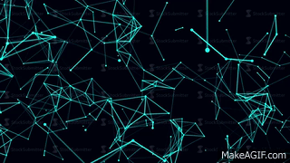
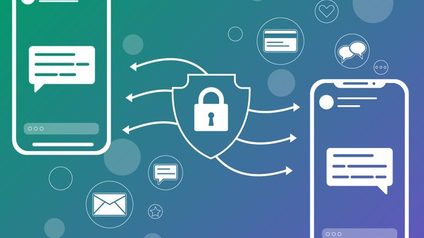
Main Features
End-to-End Encryption: Messages are encrypted, readable only by sender and recipient. Used 3DES,RSA,Hashing
Real-Time Messaging: Instant communication using Socket.io.
Machine Learning Integration: Enhancing security and user experience.

Slide 4


Design and Architecture
Architecture Overview: Client-server model ensuring security, scalability, and performance.
Client-Side: Note.js with crypto.js for encryption.
Server-Side: Node.js
Real-Time Communication: Socket.io for messaging.

Slide 5
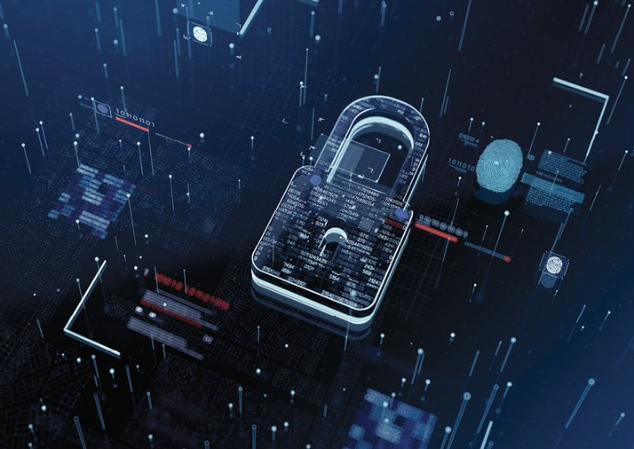
Security Measures
User Authentication: Secure login .
Data Encryption: 3DESfor data at rest and in transit use RSA.
Additional Features: Spam message detection through machine learning.

Slide 6

Development Environment
Operating Systems: Compatibility with Windows and Linux.
Front-End: Node .js, CSS , Html
Back-End: Node.js, Express.js, Socket.io.
Machine Learning

Slide 7

Security Audit and Findings
Comprehensive testing to identify security vulnerabilities from using OWSAP ZAP tool
Identified Vulnerabilities
CSP: Wildcard Directive
Content Security Policy (CSP) Header Not Set
Cross-Domain Misconfiguration
Missing Anti-clickjacking Header

Slide 8

Market and Future Developments
Market Needs: Growing demand for secure and user-friendly chat applications.
Future Enhancements: Expanding machine learning capabilities, adding more security features, improving user interface.

Slide 9
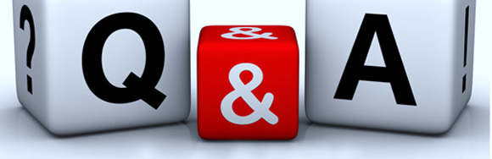

Slide 10

Thank you for exploring Link Mine 2024 with us!
Member 1-NILUPUL S.A.-IT21167478
Member 2-DE ZOYSA A.S.-IT21167096
Module-(IE3042)Secure Software System BSc. Information Technology specializing in Cyber Security (UG)

